Slide 1
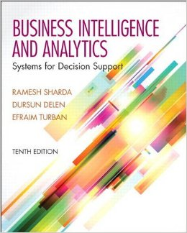
Business Intelligence and Analytics: Systems for Decision Support
(10th Edition)
Chapter 4:
Business Reporting,
Visual Analytics, and Business
Performance Management

Slide 2
Learning Objectives
Define business reporting and understand its historical evolution
Recognize the need for and the power of business reporting
Understand the importance of data/information visualization
Learn different types of visualization techniques
Appreciate the value that visual analytics brings to BI/BA
…
(Continued…)

Slide 3
Learning Objectives
Know the capabilities and limitations of dashboards
Understand the nature of business performance management (BPM)
Learn the closed-loop BPM methodology
Describe the basic elements of balanced scorecards

Slide 4
Opening Vignette…
Self-Service Reporting Environment Saves Millions For Corporate Customers
Background
Business Challenge
Solution
Results
Answer & discuss the case questions.

Slide 5
Questions for the Opening Vignette
What does Travel and Transport, Inc., do?
Describe the complexity and the competitive nature of the business environment in which Travel and Transport, Inc., functions.
What were the main business challenges?
What was the solution? Implementation?
Why do you think a multi-vendor, multi-tool solution was implemented?
List and comment on three main benefits of the implemented system.

Slide 6
Business Reporting Definitions and Concepts
Report = Information → Decision
Report?
Any communication artifact prepared to convey specific information
A report can fulfill many functions
To ensure proper departmental functioning
To provide information
To provide the results of an analysis
To persuade others to act
To create an organizational memory

Slide 7
What is a Business Report?
A written document that contains information regarding business matters.
Purpose: to improve managerial decisions
Source: data from inside and outside the organization (via the use of ETL)
Format: text + tables + graphs/charts
Distribution: in-print, email, portal/intranet
Data acquisition → Information generation → Decision making → Process management

Slide 8
Business Reporting

Slide 9
Key to Any Successful Report
Clarity …
Brevity …
Completeness …
Correctness …
Report types (in terms of content and format)
Informal – up to 10 pages; routine and internal; follow a letter or memo format.
Formal – 10-100 pages; cover + summary + text; based on deep research or analytic study.
Short report – periodic, informative, investigative.

Slide 10
Application Case 4.1
Delta Lloyd Group Ensures Accuracy and Efficiency in Financial Reporting
Questions for Discussion
How did Delta Lloyd Group improve accuracy and efficiency in financial reporting?
What were the challenges, the proposed solution, and the obtained results?
Why is it important for Delta Lloyd Group to comply with industry regulations?

Slide 11
Types of Business Reports
Metric Management Reports
Help manage business performance through metrics (SLAs for externals; KPIs for internals)
Can be used as part of Six Sigma and/or TQM
Dashboard-Type Reports
Graphical presentation of several performance indicators in a single page using dials/gauges
Balanced Scorecard-Type Reports
Attempts to present an integrated view of success in an organization.
Include financial, customer, business process, and learning & growth indicators

Slide 12
Components of Business Reporting Systems
Seven Common Characteristics
OLTP (online transaction processing)
A system that measures some aspect of the real world as events (e.g., transactions) and records them into enterprise databases.
Examples: ERP, POS, SCM, RFID, Sensors, Web, …
Data supply
A system that takes recorded events/transactions and delivers them reliably to the reporting system. The data access can be push or pull. It can also be polled (or batched periodically), or tiggered (or online) in case of specific events.
ETL
This is the intermediate step where these recorded transactions/events are checked for quality, put into the appropriate format, and inserted into the desired data format.

Slide 13
Components of Business Reporting Systems (Cont.)
Data storage
The storage area for the data and meta data.
Usually: RDMS, DM, DW, ODS. Often employs OLAP functions
Business logic
The explicit steps of how the recorded data are to be converted into metrics, scorecards, or dashboards.
Publication medium
The systems that builds the various reports and hosts them (for users) or disseminates them (to users).
These systems may also provide notification, annotation, collaboration, and other services.
Assurance
A good business reporting system is expected to offer a quality service to its users. This includes determining if and when the right information is to be delivered to the right people in the right way/format.

Slide 14
Application Case 4.2
Flood of Paper Ends at FEMA
Questions for Discussion
What is FEMA and what does it do?
What are the main challenges that FEMA faces in delivering its services?
How did FEMA improve its inefficient reporting practices?

Slide 15
Data and Information Visualization
“The use of visual representations to explore, make sense of, and communicate data.”
Data visualization vs. Information visualization
Information = aggregation, summarization, and contextualization of data
Related to the fields of information graphics, scientific visualization, and statistical graphics.
Often includes charts, graphs, as well as the other types of visual elements used to create scorecards and dashboards.

Slide 16
Application Case 4.3
Tableau Saves Blastrac
Thousands of Dollars with
Simplified Information Sharing
Questions for Discussion
How did Blastrac achieve significant cost saving in reporting and information sharing?
What were the challenge, the proposed solution, and the obtained results?

Slide 17
A Brief History of Data Visualization
Data visualization can date back to the second century AD
Most developments have occurred in the last two and a half centuries
Until recently it was not recognized as a discipline
Today’s most popular visual forms date back a few centuries
Geographical exploration, mathematics, and popularized history spurred the creation of early maps, graphs, and timelines as far back as the 1600s
William Playfair is widely credited as the inventor of the modern chart having created the first line and pie charts

Slide 18
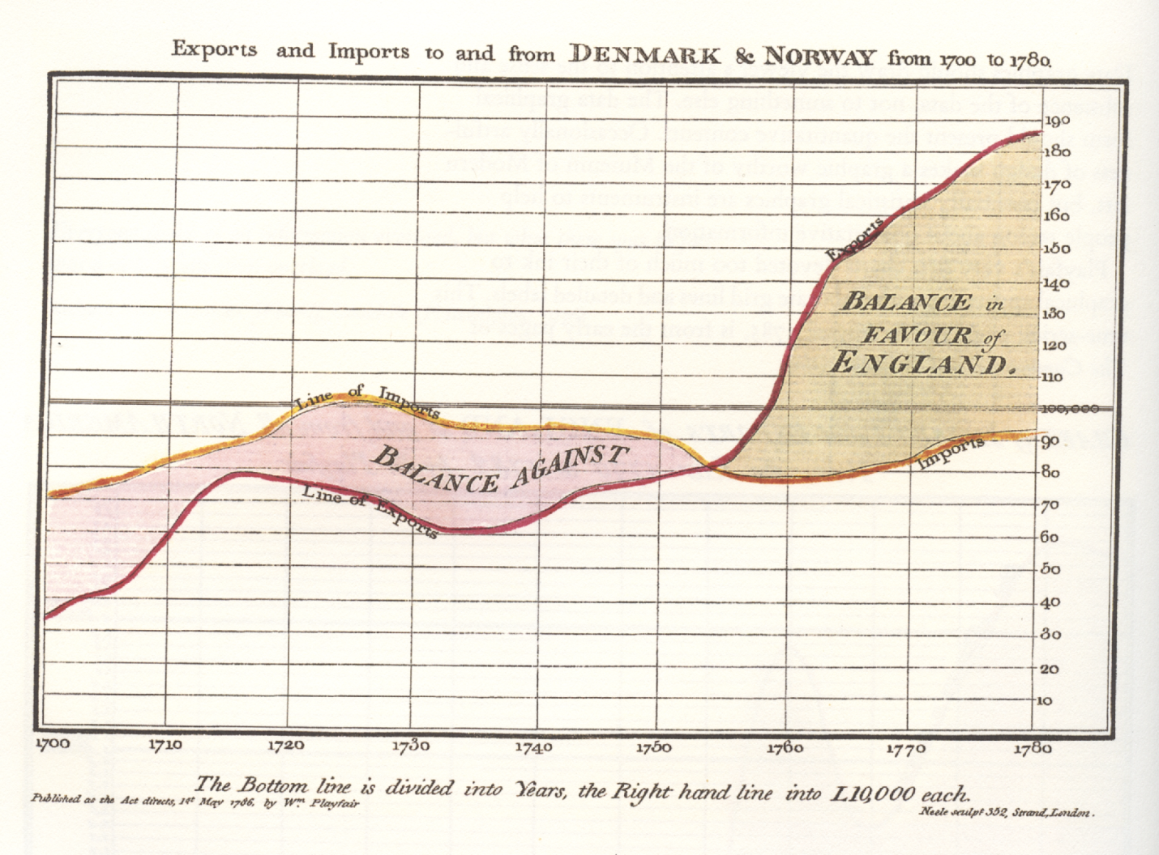
The First Pie Chart Created by William Playfair in 1801

Slide 19
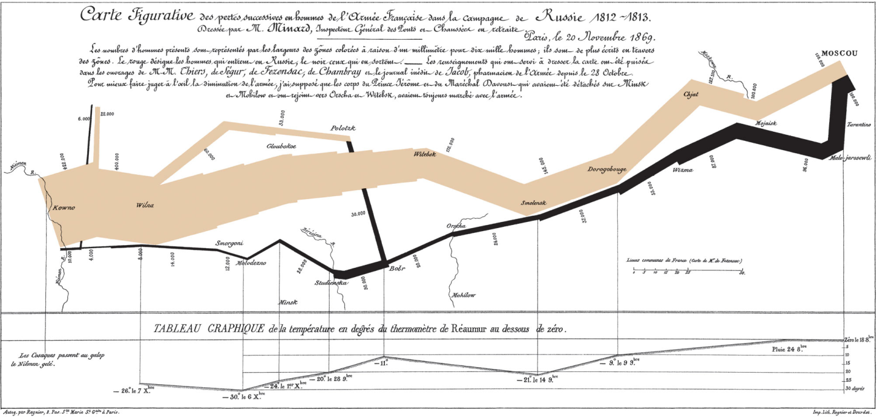
Decimation of Napoleon’s Army During the 1812 Russian Campaign
Perhaps the most notable innovator of information graphics during this period was Charles Joseph Minard, who graphically portrayed the losses suffered by Napoleon's army in the Russian campaign of 1812
By Charles Joseph Minard

Slide 20
A Brief History of Data Visualization
1900s –
more formal attitude toward visualization
focus on aspects such as color, value scales, and labeling
Publication of the book “Semiologie Graphique”, by Jacques Bertin” (which some say serves as the theoretical foundation of modern information visualization).
2000s –
Emergence of Internet as the medium for information visualization → raising visual literacy
Spurred the design of new forms that incorporate interaction, animation, 3D graphics-rendering technology, virtual worlds, real-time data feed
2010s and beyond – ?

Slide 21
Application Case 4.4
TIBCO Spotfire Provides Dana-Farber Cancer Institute with Unprecedented Insight into Cancer Vaccine Clinical Trials
Questions for Discussion
How did Dana-Farber Cancer Institute use TIBCO Spotfire to enhance information reporting and visualization?
What were the challenges, the proposed solution, and the obtained results?

Slide 22
Different Types of Charts and Graphs
Which one to use? Where and when?
Basic Charts and Graphs
Line Chart
Bar Chart
Pie Chart
Scatter Plot
Bubble Chart
Specialized Charts and Graphs
Histogram
Gantt Chart
PERT Chart
Geographic Map
Bullet Graph
Heat Map / Tree Map
Highlight Table

Slide 23
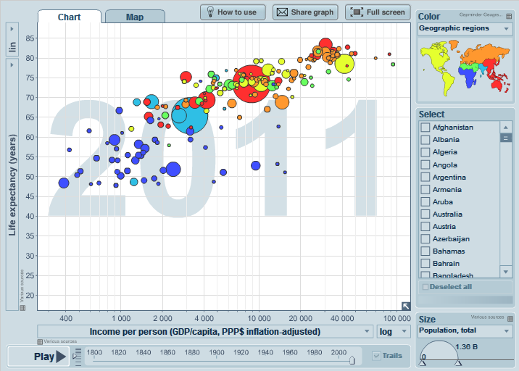
A Gapminder Chart Wealth and Health of Nations
See gapminder.org for
interesting animated examples

Slide 24
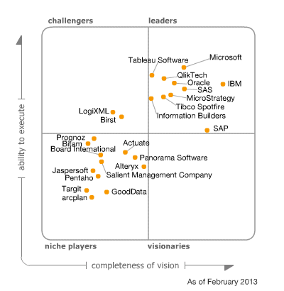
The Emergence of Data Visualization And Visual Analytics
Summarizes factors such as the vendor's financial viability, market responsiveness, product development, sales channels and customer base.
Magic Quadrant for Business Intelligence and Analytics Platforms (Source: Gartner.com)
Many data visualization companies are in the 4th quadrant
There is a move toward visualization
Reflects the vendor's innovation, and whether the vendor drives or follows the market.

Slide 25
The Emergence of Data Visualization And Visual Analytics
Emergence of new companies
Tableau, Spotfire, QlikView, …
Increased focus by the big players
MicroStrategy improved Visual Insight
SAP launched Visual Intelligence
SAS launched Visual Analytics
Microsoft bolstered PowerPivot with Power View
IBM launched Cognos Insight
Oracle acquired Endeca

Slide 26
Visual Analytics
A recently coined term
Information visualization + predictive analytics
Information visualization
Descriptive, backward focused
“what happened” “what is happening”
Predictive analytics
Predictive, future focused
“what will happen” “why will it happen”
There is a strong move toward visual analytics
What is the difference between information visualization and visual analytics?

Slide 27
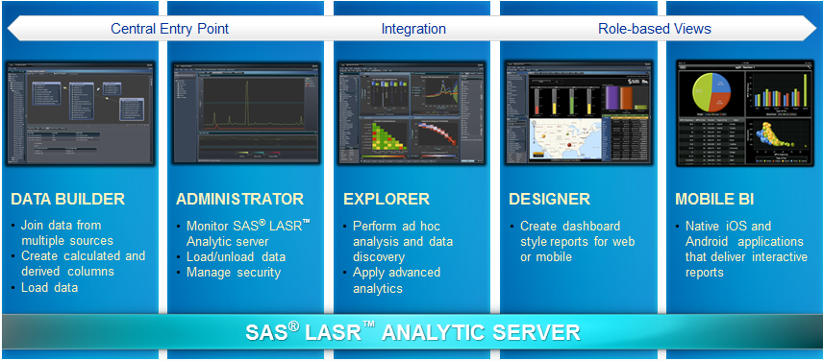
Visual Analytics by SAS Institute
SAS Visual Analytics Architecture
Big data + In memory + Massively parallel processing + ..

Slide 28
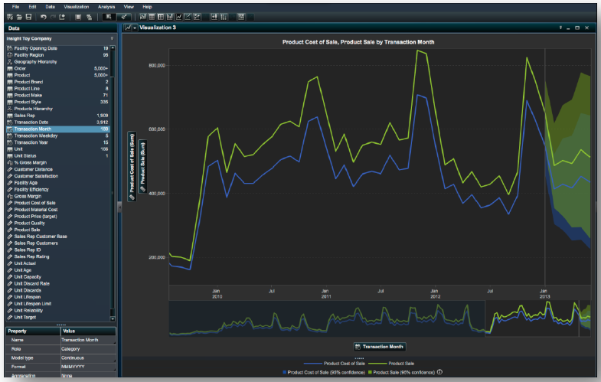
Visual Analytics by SAS Institute
At teradatauniversitynetwork.com, you can learn more about SAS VA, experiment with the tool

Slide 29
Performance Dashboards
Performance dashboards are commonly used in BPM software suites and BI platforms
Dashboards provide visual displays of important information that is consolidated and arranged on a single screen so that information can be digested at a single glance and easily drilled in and further explored

Slide 30
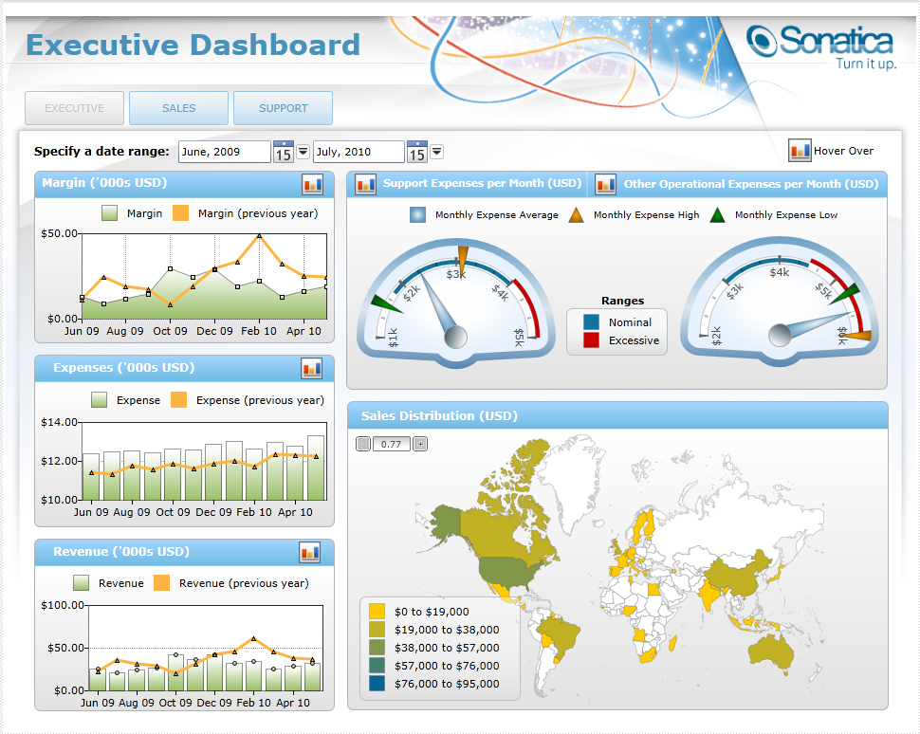
Performance Dashboards

Slide 31
Performance Dashboards (Dashboard design)
Three layer of information
Monitoring. Graphical, abstracted data to monitor KPIs.
Analysis. Summarized dimensional data to analyze the root cause of problems.
Management. Detailed operational data that identify what actions to take to resolve a problem.
The fundamental challenge of dashboard design is to display all the required information on a single screen, clearly and without distraction, in a manner that can be assimilated quickly

Slide 32
Performance Dashboards
To speed assimilation of the numbers, the numbers need to be placed in context. This can be done by comparing the numbers of interest to other baseline or target numbers.
Some of the common comparisons that are typically made in business intelligence systems include comparisons against:
past values,
forecasted values,
targeted values,
benchmark or average values,
multiple instances of the same measure, and
the values of other measures (e.g. , revenues versus costs).

Slide 33
Application Case 4.6
Saudi Telecom Company Excels with Information Visualization
Questions for Discussion
Why do you think telecommunication companies are among the prime users of information visualization tools?
How did Saudi Telecom use information visualization?
What were their challenges, the proposed solution, and the obtained results?

Slide 34
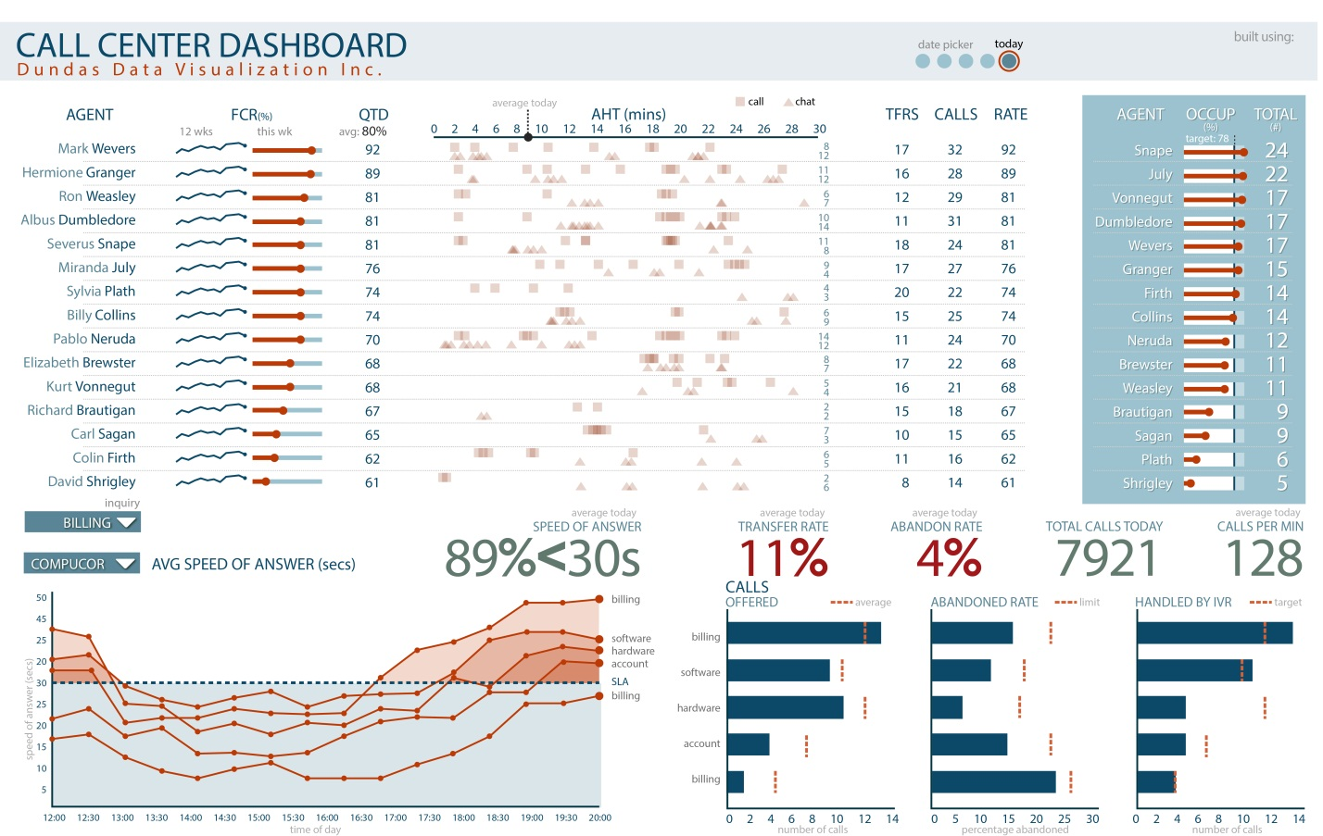
Application Case 4.6

Slide 35
Performance Dashboards
All well-designed dashboard and other information visualizations possess the following characteristics
They use visual components (e.g., charts, performance bars, sparklines, gauges, meters, stoplights) to highlight data and exceptions that require action.
Transparent to the user, meaning that they require minimal training and are extremely easy to use
Combine data from a variety of systems into a single, summarized, unified view of the business
Enable drill-down or drill-through to underlying data sources or reports
Present a dynamic, real-world view with timely data
Require little coding to implement/deploy/maintain

Slide 36
Best Practices in Dashboard Design
Benchmark KPIs with Industry Standards
Wrap the Metrics with Contextual Metadata
Validate the Design by a Usability Specialist
Prioritize and Rank Alerts and Exceptions
Enrich Dashboard with Business-User Comments
Present Information in Three Different Levels
Pick the Right Visual Constructs
Provide for Guided Analytics

Slide 37
Business Performance Management (BPM)
Business Performance Management (BPM) is…
A real-time system that alerts managers to potential opportunities, impending problems and threats, and then empowers them to react through models and collaboration.
Also called corporate performance management (CPM by Gartner Group), enterprise performance management (EPM by Oracle), strategic enterprise management (SEM by SAP)

Slide 38
Business Performance Management (BPM)
BPM refers to the business processes, methodologies, metrics, and technologies used by enterprises to measure, monitor, and manage business performance.
BPM encompasses three key components
A set of integrated, closed-loop management and analytic processes, supported by technology that addresses financial as well as operational activities.
Tools for businesses to define strategic goals and then measure/manage performance against them
A core set of processes, including financial and operational planning, consolidation and reporting, modeling, analysis, and monitoring of key performance indicators (KPis), linked to organizational strategy

Slide 39
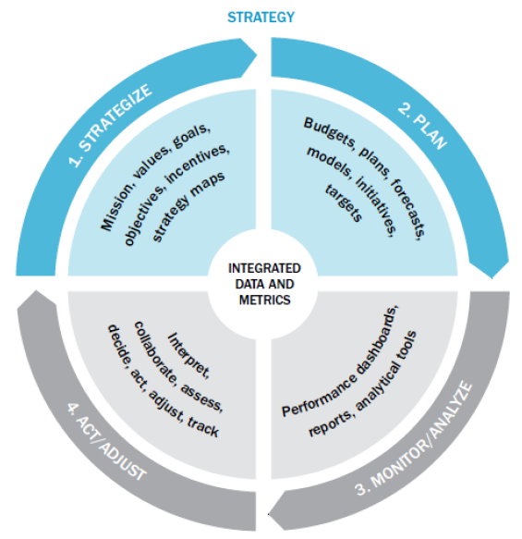
A Closed-Loop Process to Optimize Business Performance
Process Steps
Strategize
Plan
Monitor/analyze
Act/adjust
Each with its own process steps

Slide 40
Strategize: Where Do We Want to Go?
Strategic planning
Common tasks for the strategic planning process:
Conduct a current situation analysis
Determine the planning horizon
Conduct an environment scan
Identify critical success factors
Complete a gap analysis
Create a strategic vision
Develop a business strategy
Identify strategic objectives and goals

Slide 41
Plan: How Do We Get There?
Operational planning
Operational plan: plan that translates an organization’s strategic objectives and goals into a set of well-defined tactics and initiatives, resources requirements, and expected results for some future time period (usually a year).
Operational planning can be
Tactic-centric (operationally focused)
Budget-centric plan (financially focused)

Slide 42
Monitor/Analyze: How Are We Doing?
A comprehensive framework for monitoring performance should address two key issues:
What to monitor?
Critical success factors
Strategic goals and targets
…
How to monitor?
…

Slide 43
Act and Adjust: What Do We Need to Do Differently?
Success (or mere survival) depends on new projects: creating new products, entering new markets, acquiring new customers (or businesses), or streamlining some process.
Many new projects and ventures fail!
What is the chance of failure?
60% of Hollywood movies fail
70% of large IT projects fail, …

Slide 44
Application Case 4.7
IBM Cognos Express Helps Mace for Faster and Better Business Reporting
Questions for Discussion
What was the reporting challenge Mace was facing? Do you think this is an unusual challenge specific to Mace?
What was the approach for a potential solution?
What were the results obtained in the short term, and what were the future plans?

Slide 45
Performance Measurement
Performance measurement system
A system that assists managers in tracking the implementations of business strategy by comparing actual results against strategic goals and objectives
Comprises systematic comparative methods that indicate progress (or lack thereof) against goals

Slide 46
KPIs and Operational Metrics
Key performance indicator (KPI)
A KPI represents a strategic objective and metrics that measure performance against a goal
Distinguishing features of KPIs
Strategy
Targets
Ranges
Encodings
Time frames
Benchmarks

Slide 47
Performance Measurement
Key performance indicator (KBI)
Outcome KPIs vs. Driver KPIs
(lagging indicators (leading indicators
e.g., revenues) e.g., sales leads)
Operational areas covered by driver KPIs
Customer performance
Service performance
Sales operations
Sales plan/forecast

Slide 48
Performance Measurement System
Balanced Scorecard (BSC)
A performance measurement and management methodology that helps translate an organization’s financial, customer, internal process, and learning and growth objectives and targets into a set of actionable initiatives
"The Balanced Scorecard: Measures That Drive Performance” (HBR, 1992)

Slide 49
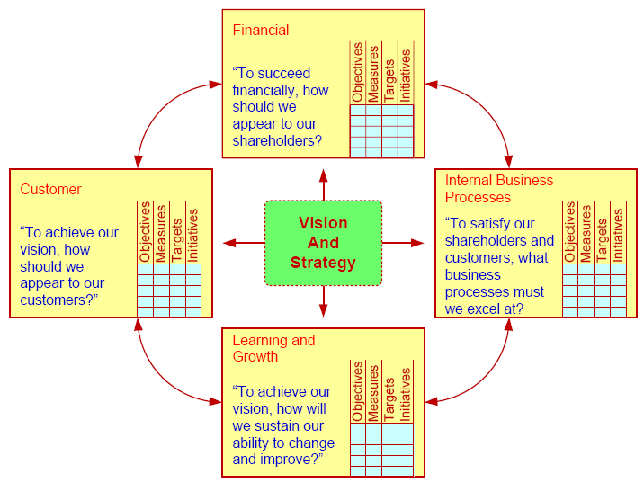
Balanced Scorecard
The meaning of “balance” ?

Slide 50
Six Sigma as a Performance Measurement System
Six Sigma
A performance management methodology aimed at reducing the number of defects in a business process to as close to zero defects per million opportunities (DPMO) as possible

Slide 51
Six Sigma as a Performance Measurement System
The DMAIC performance model
A closed-loop business improvement model that encompasses the steps of defining, measuring, analyzing, improving, and controlling a process
Lean Six Sigma
Lean manufacturing / lean production
Lean production versus six sigma?

Slide 52
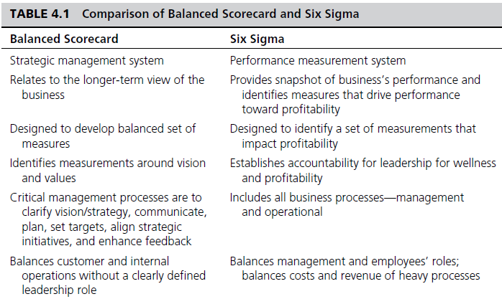
Comparison of Balanced Scorecard and Six Sigma

Slide 53
Application Case 4.8
Expedia.com’s Customer Satisfaction Scorecard
Questions for Discussion
Who are the customers for Expedia.com? Why is customer satisfaction a very important part of their business?
How did Expedia.com improve customer satisfaction with scorecards?
What were the challenges, the proposed solution, and the obtained results?

Slide 54
End of the Chapter
Questions, comments

Slide 55

All rights reserved. No part of this publication may be reproduced, stored in a retrieval system, or transmitted, in any form or by any means, electronic, mechanical, photocopying, recording, or otherwise, without the prior written permission of the publisher. Printed in the United States of America.

